Slide 1
Strategic Communications Update EC-76
Brigitte Perrin, Head of Communications
2 March 2023

Slide 2
WMO Strategic Communications objectives
Make WMO the strongest brand in the UN system
Lead the conversation on climate, weather and water and all related environmental matters
Invigorate the communication culture among staff and Members
Prepare people, including the most vulnerable, for a changing climate

Slide 3
Key results 2022
Media:
113 news published
35 press releases
Social media:
149,505 new followers
+19.2% annual growth rate
928,867 total followers
Upcoming milestone: 1 million
Website:
3.2 million visitors (+9%)
6 million pages viewed (+8%)
Video:
66 videos produced
20+ group photos
Notes:
The media and social media environment is changing at a very fast pace.Recent examples with Twitter, and now with debate around ChatGPT shows
Growing media coverage – campaigns/reports and extreme weather events
How many of you active on social media – some of you LinkedIn – fastest growing channel
Invigorate our social networks with your contributions and your experts’
Flagship reports – short videos – key figures – quotes
-> Yearly updates at EC with enhanced methodology – collaboration with MERP

Slide 4
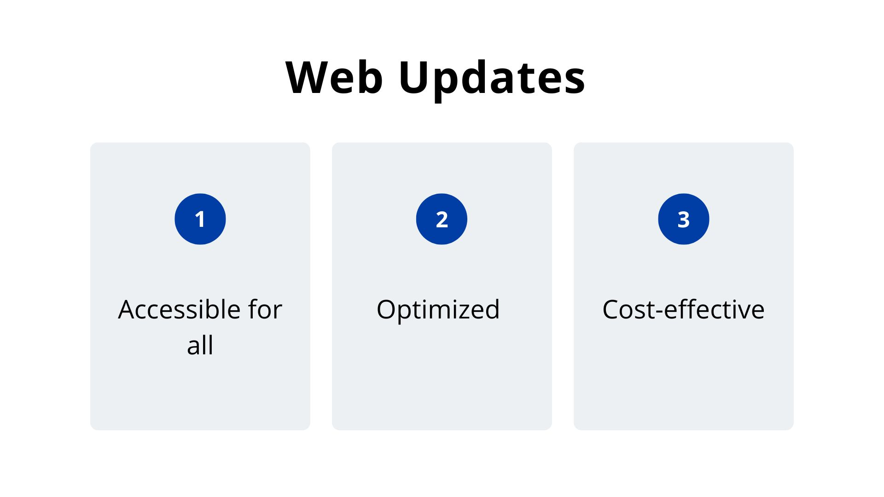
Notes:
Cmnity very strong and engaged
Introducing your work to people who are not familiar with your topics
23 March – intentionnally creating content using plain language to take our chance to reach new audiences
AW4All need to be inclusive – need to reach out to this new audience
23 March – you will see level 1 content featured. Updated pages level 2 and 3 will be rolled out in the coming months.

Slide 5
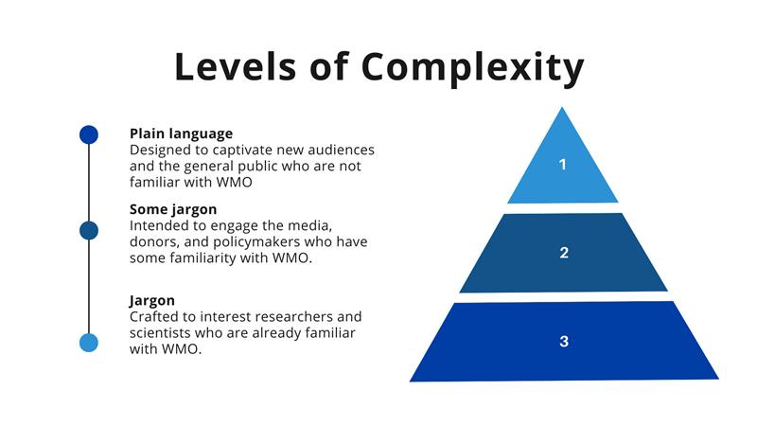
Jargon = special words and phrases that are used by particular groups of people, especially in their work (Cambridge Dictionary)
Notes:
Cmnity very strong and engaged
Introducing your work to people who are not familiar with your topics
23 March – intentionnally creating content using plain language to take our chance to reach new audiences
AW4All need to be inclusive – need to reach out to this new audience
23 March – you will see level 1 content featured. Updated pages level 2 and 3 will be rolled out in the coming months.

Slide 6
Communication focal points
bit.ly/commsNMHSs
Notes:
Support on two things
Call for focal points –
150th Anniversary
Revitalize the network
Ensure two-way information flow – Anniversary – EW4All – someone we can contact
Discuss regional capacities – needs
105 responses so far, thank you!
Linking this anniversary to most of the events taking place in 2023, including other anniversary celebrations in NMHSs
A special event will take place in September in Geneva and Vienna.
An exhibition will be prepared with content provided by Members and the WMO community
Theme: The Future of Weather, Climate and Water across Generations. It will include three moments: “Looking back”, “Living the present” and “Looking forward”.

Slide 7
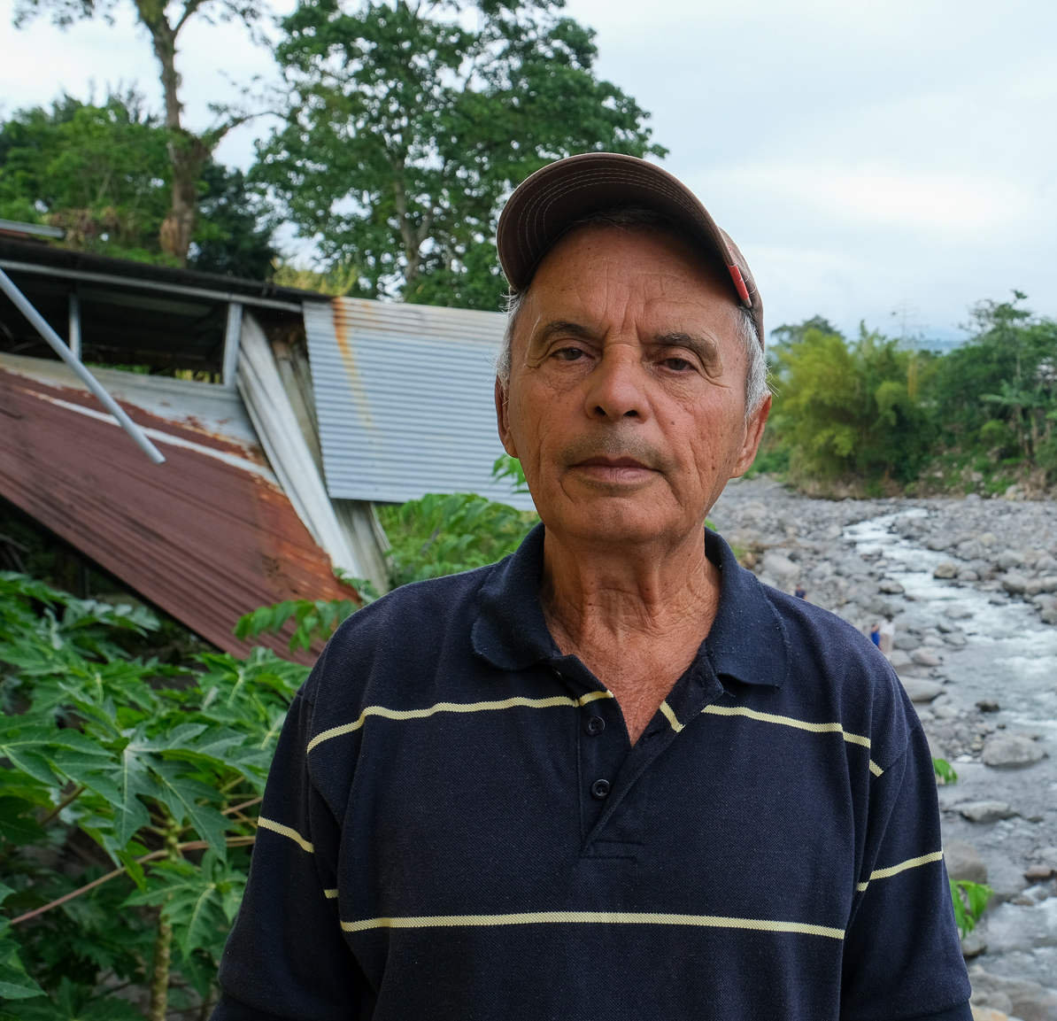
For decision
The Executive Council decides:
World Meteorological Day theme for 2024
At the frontline of climate action
Notes:
Selwin Hart – conversation on EW4All
Colleagues in Hydrology embeded us in a project in Costa Rica –Turrialba – Early Warnings for floods – we met people who lost livelihoods – interview people – telling a story
Turrialba Survivor - JCF

Slide 8
Thank you!

